Slide 1
City growth and Zipf’s Law
Hélène van Heijningen & Matthijs Brouns
CPB: Bureau for Economic Policy Analysis

Slide 2
Contents
CPB and Zipf’s law
Research question & Approach
Narrative
Model logic
Verification & Validation
Experimental Design
Model experimentation
Conclusions
Future research

Slide 3
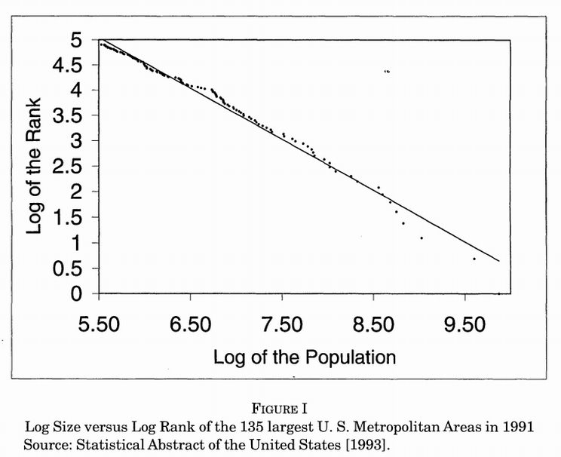
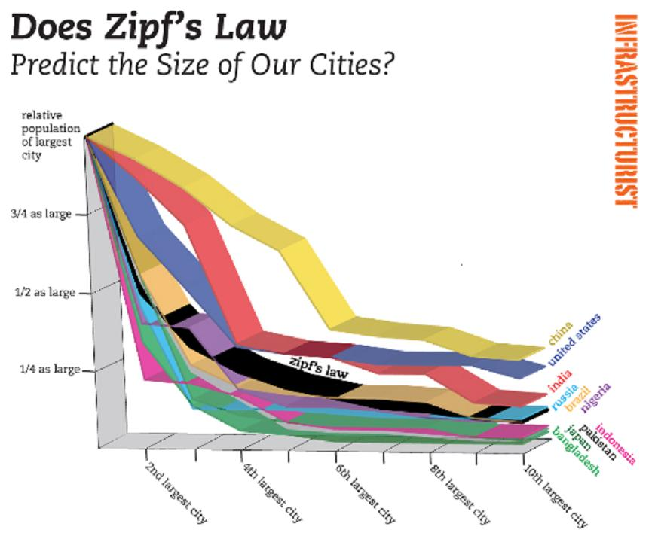
CPB and Zipf’s Law
The largest cities in a country show a Zipfian distribution
CPB:
Can we influence this type of city growth?
Can we design policies knowing this type of behaviour occurs?
What causes the Zipf’s law to emerge?

Slide 4
Research question & Approach
Focus: Decisions made on household level
Research question:
How do decisions made at household level influence moving behaviour between cities to cause the emergence of the Zipf’s law?
Approach:
Based on what decisions would we move?
Literature research

Slide 5
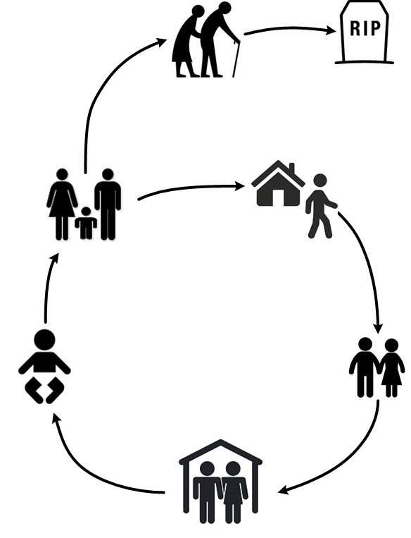
Narrative
65+ Move less and prefer the countryside
Children (16-23) move out to more attractive city, a new household is formed
Children grow up
Young adults move
very often
Life cycle
Couples (23-40) reproduce, their household grows
Couples form in
the same city,
households merge

Slide 6
Narrative
Having children
Borrowed utility
City size
(facilities)
Age
Moving?
Distance from current location
Time since moving
Life cycle
Job attractiveness

Slide 7
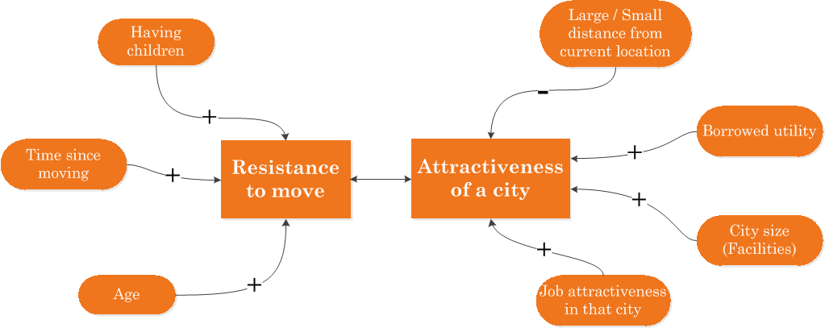
Model Logic
Rule: A household moves to a random city for which its ‘Attractiveness’ > ‘Resistance to move’
Resistance to move & Attractiveness of a city take on values between 0 and 1.

Slide 8
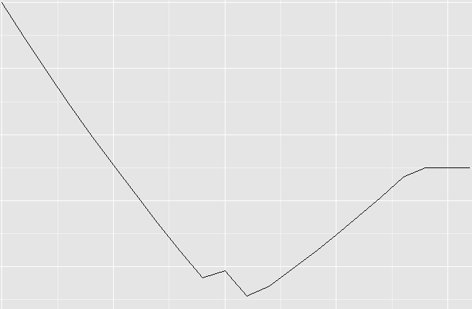
Model Logic: Resistance to Move
Gradually declining slope due to change in age of household members.
Plateau reached
Childbirth

Slide 9
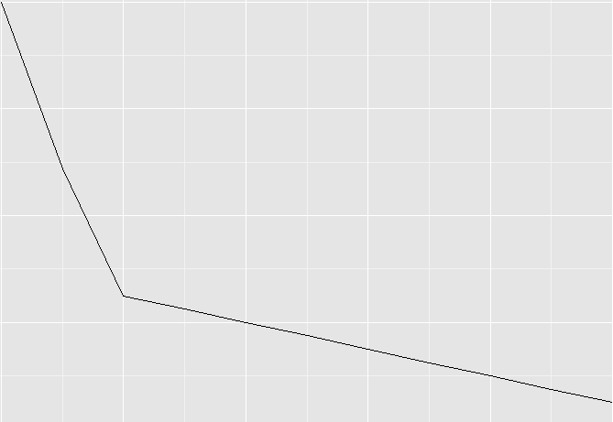
Model Logic: Job Attractiveness
Job attractiveness
Primary
sector jobs
Secondary
sector jobs
Tertiary
sector jobs
Quaternary
sector jobs
City occupancy

Slide 10
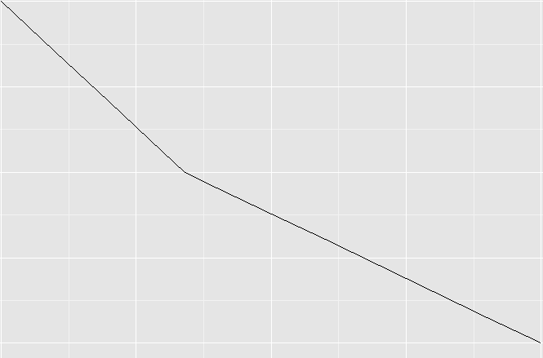
Model Logic: Job Attractiveness
Job attractiveness
Primary
sector jobs
Secondary
sector jobs
Tertiary
sector jobs
Quaternary
sector jobs
Fraction people in service / non-profit

Slide 11
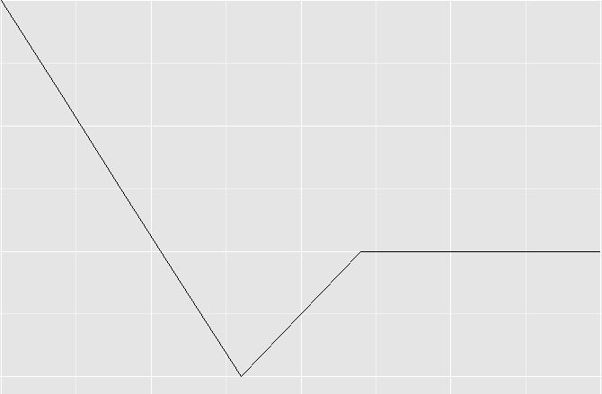
Model Logic: Job Attractiveness
Job attractiveness
Primary
sector jobs
Secondary
sector jobs
Tertiary
sector jobs
Quaternary
sector jobs
Service-like
effect
Specialization effect
Fraction people in IT / finance

Slide 12
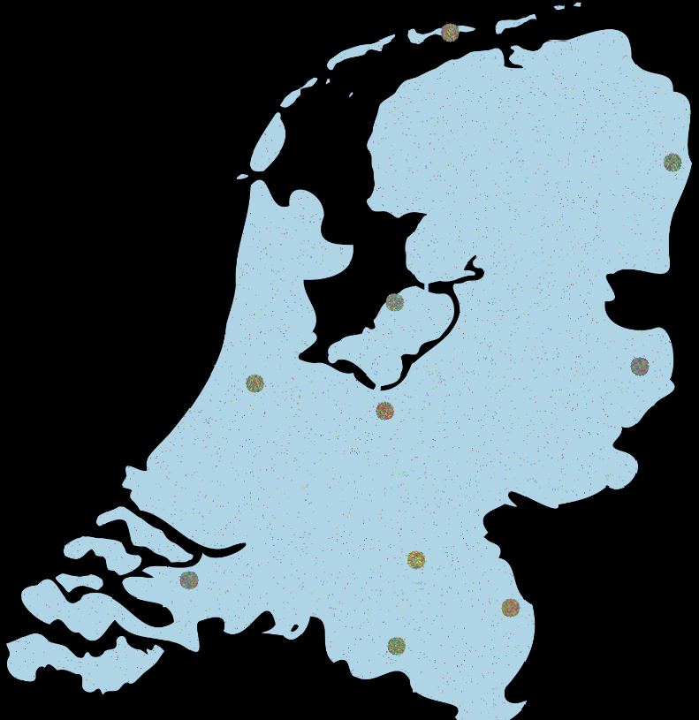
Model Output
Map with randomly
distributed cities
Households distributed
over cities & countryside
For every tick (1 year)
Total number of households
Number of households in and out of cities
Number of households for the 10 different cities

Slide 13
Verification & Validation
Verification
Falsification tests
Literature validation
Parameters and relations are based on literature
No further need for this type of validation
Face validation through expert consultation
Relations in model
…
…

Slide 14
Experimental Design
Latin hypercube
Because of long run time, limited number of runs
Which variables have the most influence on creating the desired model output?
Sum of squared errors?
R-squared?

Slide 15
Model Experimentation

Slide 16
Conclusions
Our model is able to produce cities according to a rank-size, or Zipfian, distribution
However, very specific parameter values are needed to be able to do this
Two variables seem to have the most effect:
..
..
Do we now understand why city growth behaves like this?

Slide 17
Future Research
Why doesn’t the Zipf’s law fit as well in the Netherlands as it does abroad and how does this affect decision making?
What happens when European borders disappear entirely?
Will Paris or London become the most important city?
What will happen to our cities?

Slide 18
References
http://io9.com/the-mysterious-law-that-governs-the-size-of-your-city-1479244159
http://keith-travelsinindonesia.blogspot.nl/2011/06/capital-on-move.html

